Slide 1


5005CEM Lecture 3b: Visualisation of One Variable
School of Computing, Mathematics and Data Science Coventry University
5005CEM Data Science 2022/23 Semester 2

Slide 2
Recap
Vital to classify variables as:
categorical (names or labels); or
quantitative (numerical values with magnitude)
Summarise a categorical variable by counts for each category.
Summarise a quantitative variable by:
central tendency: mean, median, mode
variability: range, interquartile range, variance, standard deviation, percentiles, z-scores

Slide 3
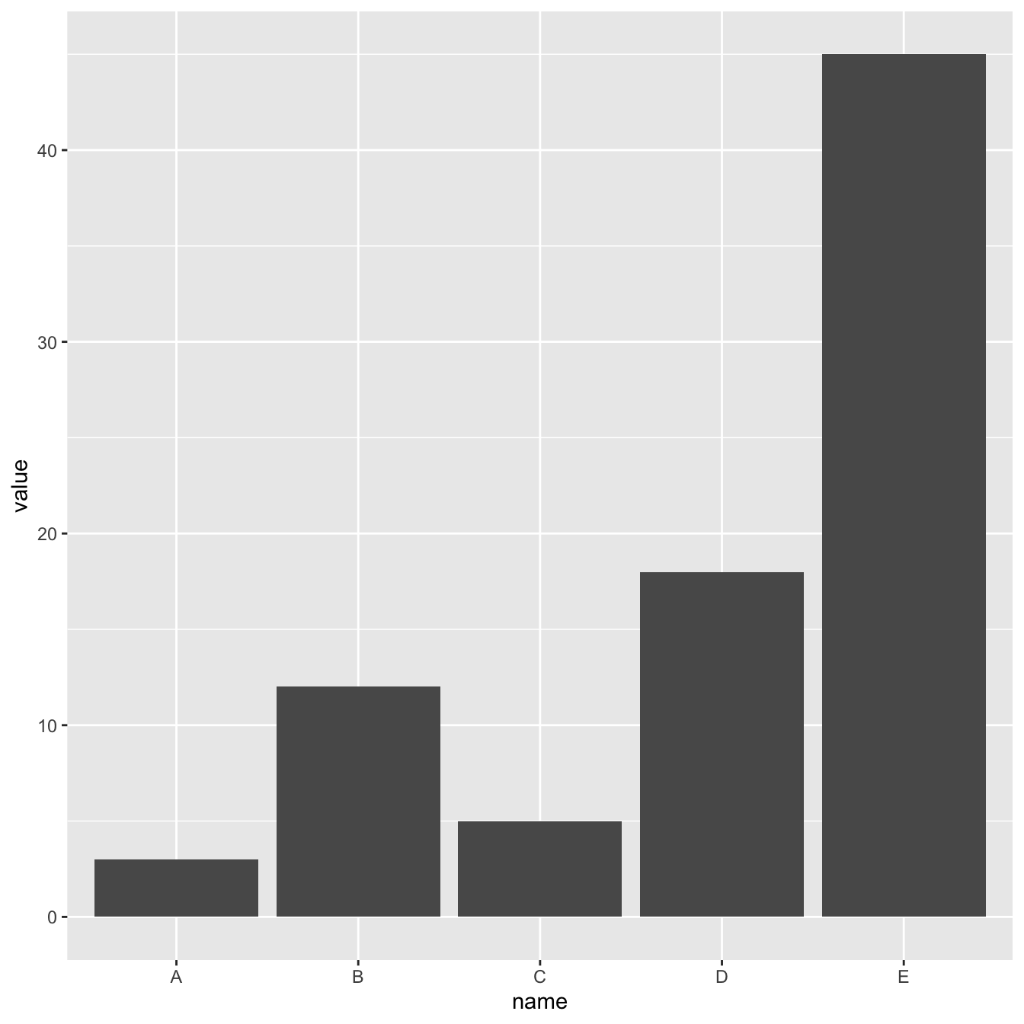
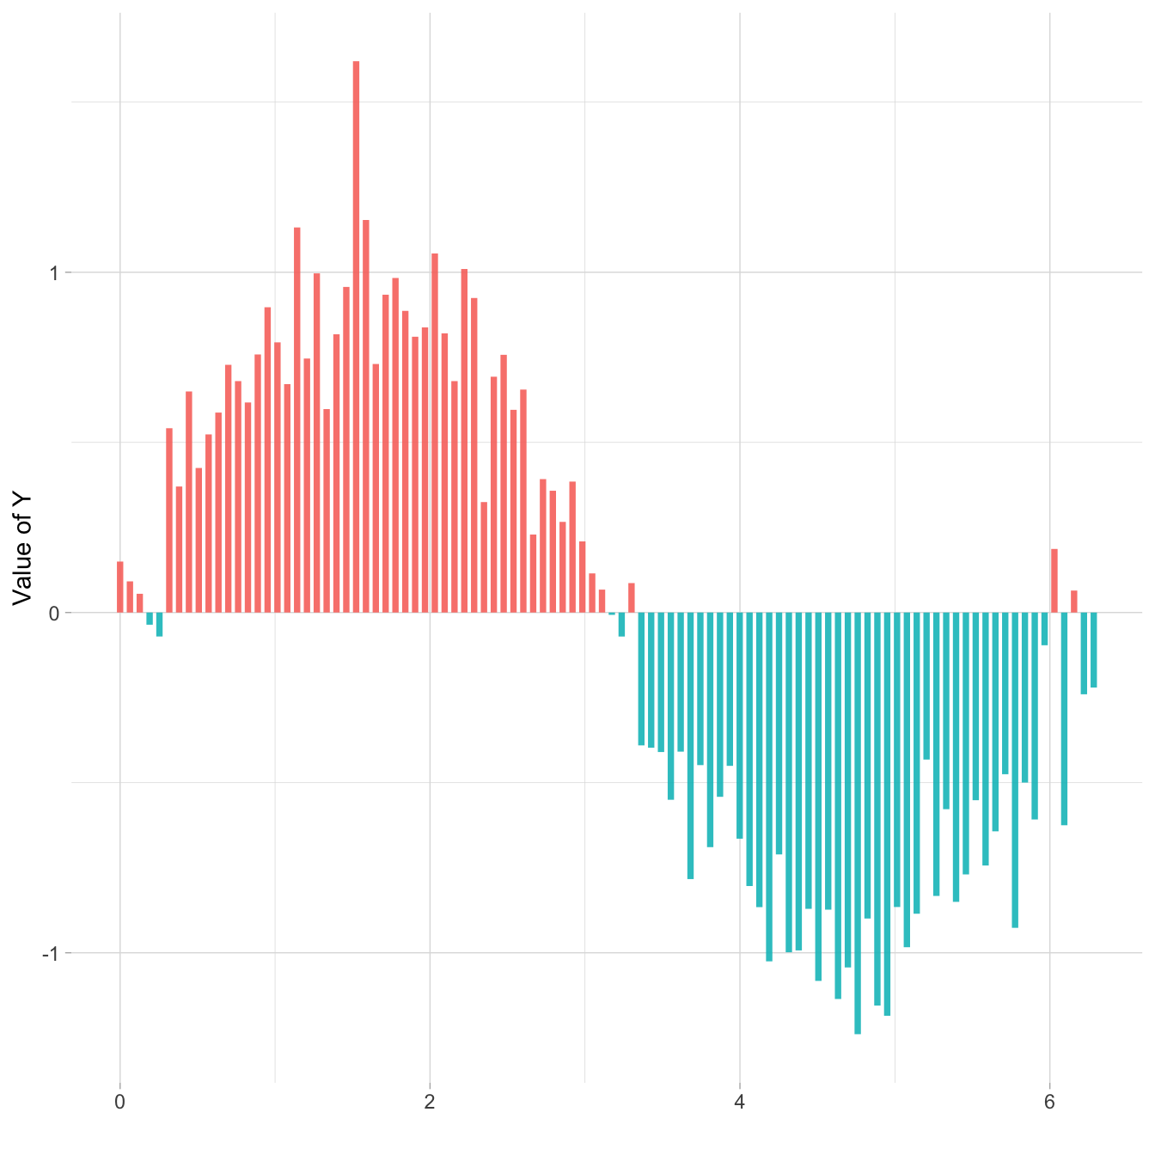
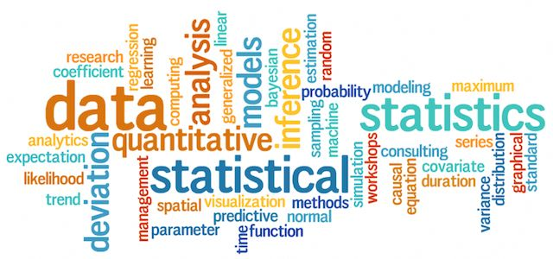
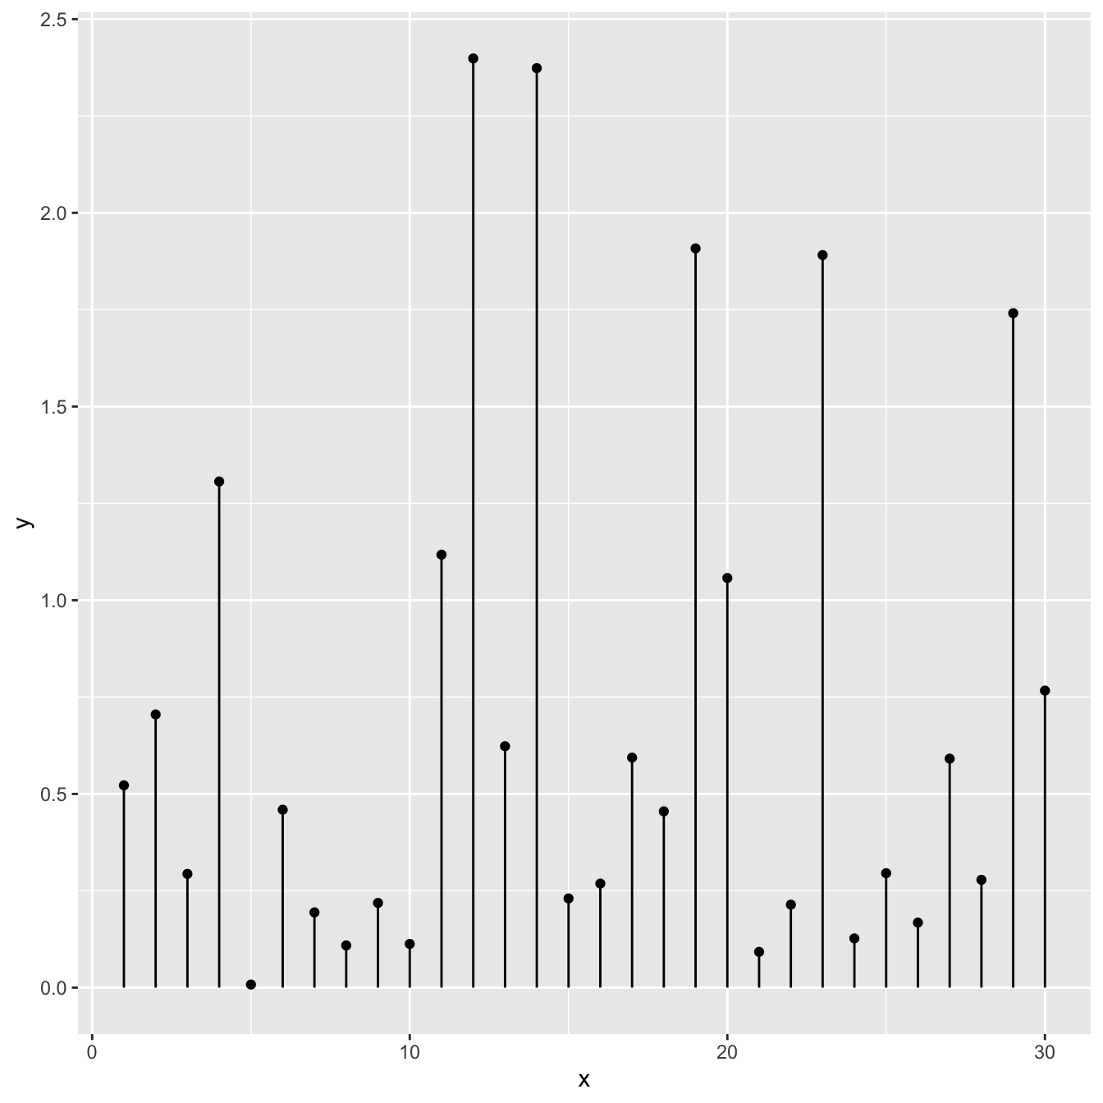

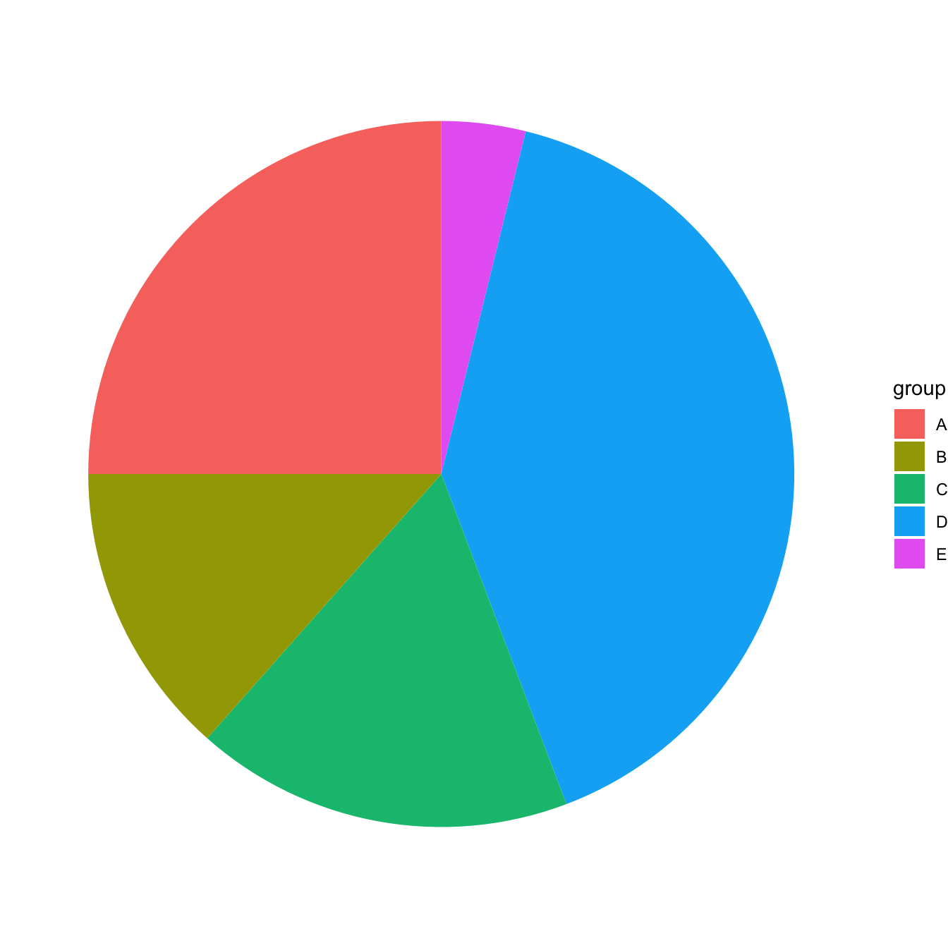
Visualisation of One Categorical Variable
Barchart (barplot)
Lollipop plot
Circular barchart
Pie chart (never use)
Word cloud
Notes:
Example plots from: https://www.r-graph-gallery.com/
Reading: https://blog.funnel.io/why-we-dont-use-pie-charts-and-some-tips-on-better-data-visualizations

Slide 4
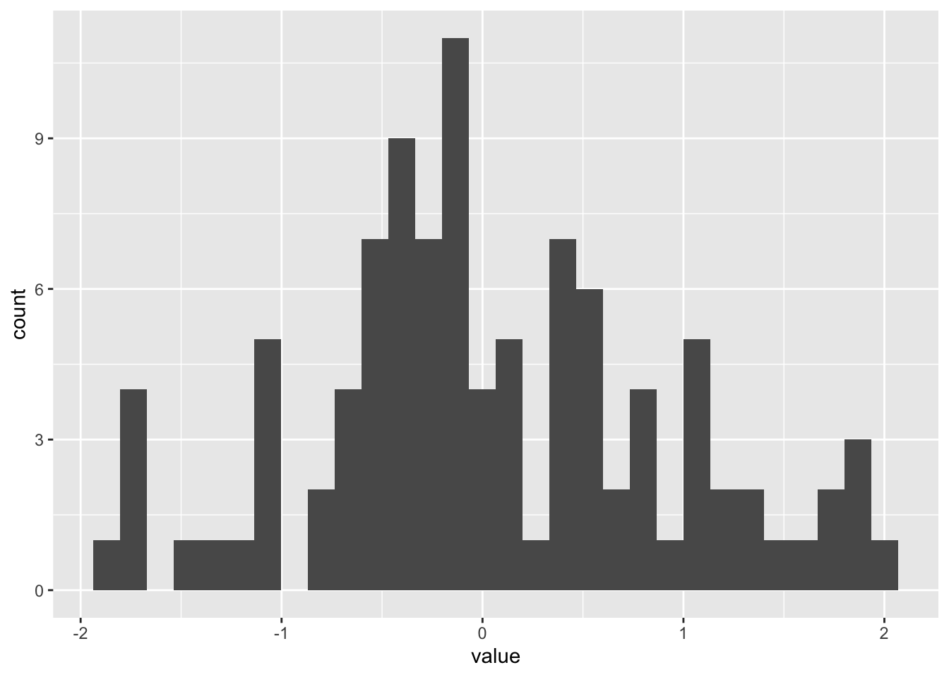
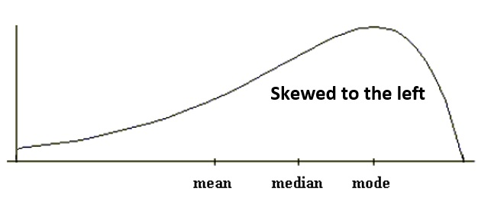
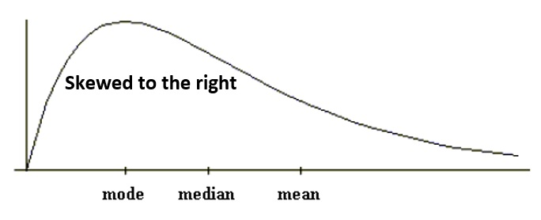
Visualisation of One Quantitative Variable
Histogram (distribution of data)
divide values into bins (intervals) and count
estimates a probability distribution
shape: symmetric or skew (long tail)
Notes:
Skew images from: https://online.stat.psu.edu/stat200/lesson/2/2.2/2.2.4/2.2.4.1

Slide 5
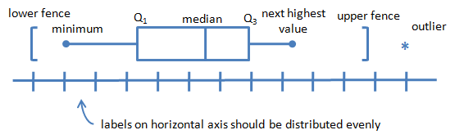
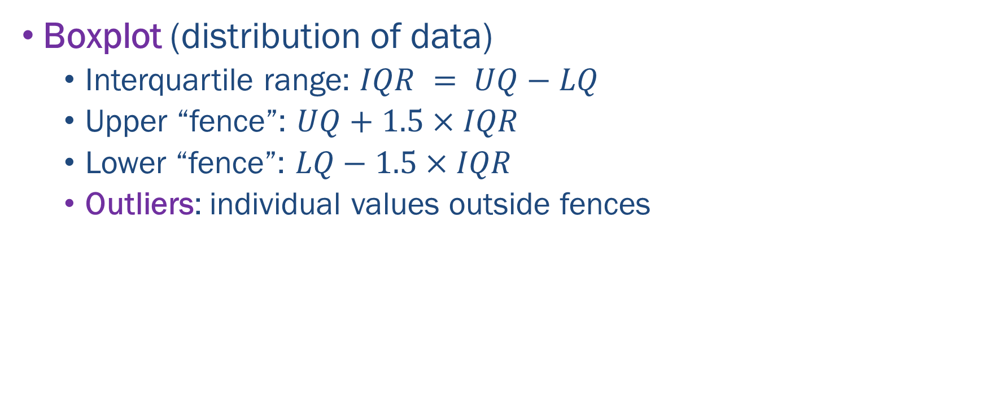
Visualisation of One Quantitative Variable
Boxplot (distribution of data)
Interquartile range: $IQR = UQ−LQ$
Upper “fence”: $UQ+1.5×IQR$
Lower “fence”: $LQ−1.5×IQR$
Outliers: individual values outside fences
Notes:
Boxplot image from: https://faculty.elgin.edu/dkernler/statistics/ch03/3-5.html

Slide 6
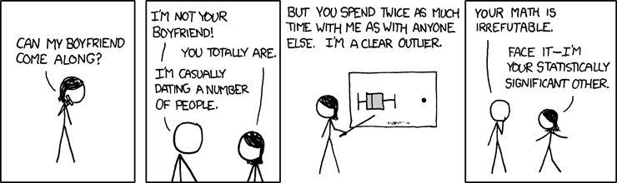
Visualisation of One Quantitative Variable
Boxplot (horizontal version)
left-to-right: outliers, min, LQ, median, UQ, max, outliers
Notes:
Cartoon from: https://xkcd.com/539/

Slide 7
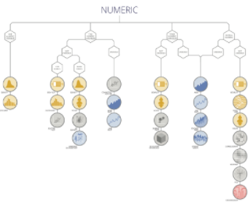
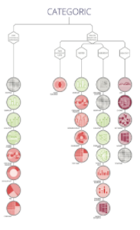
Graph Gallery
https://www.r-graph-gallery.com/
Recipes/examples using ggplot2 and the tidyverse.
https://www.data-to-viz.com/
Decision tree leads to the most appropriate graph for your data.
Look at Numeric (same as our Quantitative).
Look at Categoric (same as our Categorical).
Notes:
“We smash that together with marketing.”
https://90seconds.com/we-smash-that-together-with-marketing-matt-west-dot-loves-data/

Slide 8
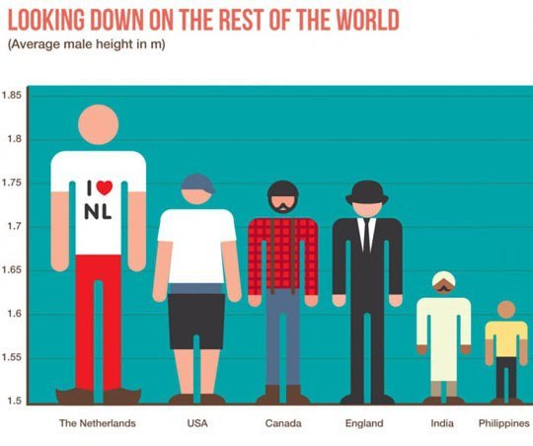
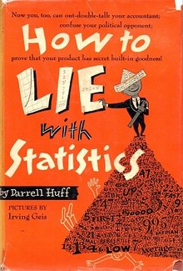
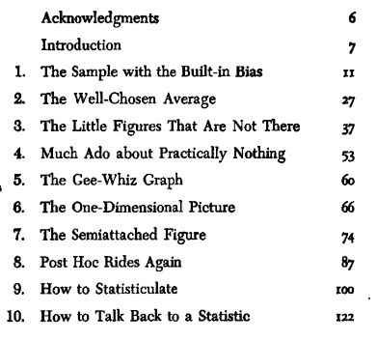
Bad Graphical Plots
“There are three kinds of lies: lies, damned lies, and statistics” — Mark Twain
How to Lie with Statistics by Darrell Huff (1954)
Notes:
https://en.wikipedia.org/wiki/How_to_Lie_with_Statistics Heights image from: http://ticktockmaths.co.uk/bad-graphs/

Slide 9

Visualisation Principles
Edward Tufte (2001). The Visual Display of Quantitative Information, 2nd edition, Graphical Press.
Graphical integrity – visual representations of data must tell the truth, “lie factor”.
Data and Ink – above all else show data, maximize the data-to-ink ratio, eliminate “chart junk”, focus on content.
Spark lines – word-sized inline graphics
Notes:
Reading: https://thedoublethink.com/tuftes-principles-for-visualizing-quantitative-information/
Reading: https://sites.google.com/site/tufteondesign/home/six-fundamental-principles-of-design

Slide 10
Summary
Vital to classify variables as categorical or quantitative.
Select and interpret visual representations for one variable (depending on categorical or quantitative)
Use the upper and lower fences (calculated from UQ, LQ) to identify outliers in a boxplot

Slide 11
Class Discussion Questions
When is a value an outlier of a quantitative variable?
Why is it not possible to draw a boxplot for a single categorical variable?
What is the difference between a barchart and a histogram?
Why is it important to maximise the data-to-ink ratio?

Slide 12
Class Discussion Questions
Consider the two quotes below and discuss whether or not they are relevant to EDA.
“The purpose of visualization is insight, not pictures.” — Ben Shneiderman
“At their best, graphics are instruments of reasoning” — Edward Tufte

